Slide 1

DAX (Data Analysis Expressions)

Slide 2
Outlines
Overview of DAX
Fundamental concepts of DAX
DAX Context
DAX Data Types
DAX Operators
DAX Functions
DAX Variables

Slide 3

DAX Overview
Data Analysis Expressions (DAX) is a formula expression language used in Analysis Services, Power BI, and Power Pivot in Excel.
DAX formulas include functions, operators, and values to perform advanced calculations and queries on data in related tables and columns in tabular data models.
Types of DAX Calculations
DAX can be used to construct two distinct kinds of expressions and calculations:
1. Calculated columns
2. Measures [Implicit and Explicit]
3. Calculated Tables

Slide 4
Calculated Columns
When you use the calculated columns, a new column will be added to your table. A calculated column is identical to any other column, except that it must contain at least one function. You can use them to make a filtered or sorted column in your table.
Calculated Measures
A field with consolidated data (a total, proportion, per cent, mean, etc.) is generated by a calculated measure.
Calculated Tables
A calculated table can be defined as a Virtual Table that is created by using a Physical Table through DAX (Data Analytic Expression). A physical Table is generally an imported table from external data sources, but this calculated table is created according to our need for a physical table by using DAX .
We can use these calculated tables for visualization purposes also in our Power Bi Dashboards. Like Physical Tables, these Calculated Tables also exhibit a relationship with the other Tables.
Notes:
https://www.geeksforgeeks.org/power-bi-how-to-create-calculated-tables/

Slide 5
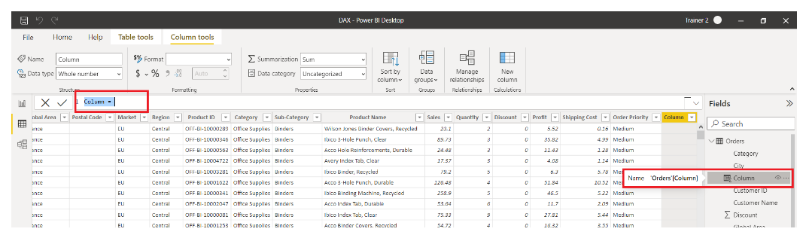
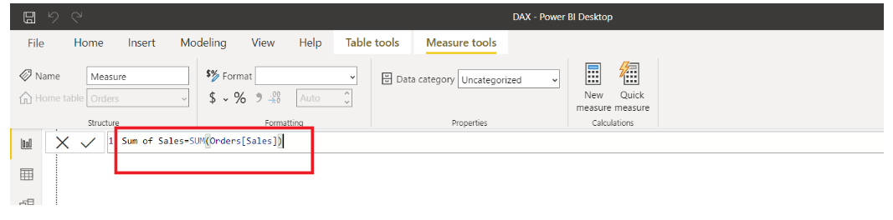
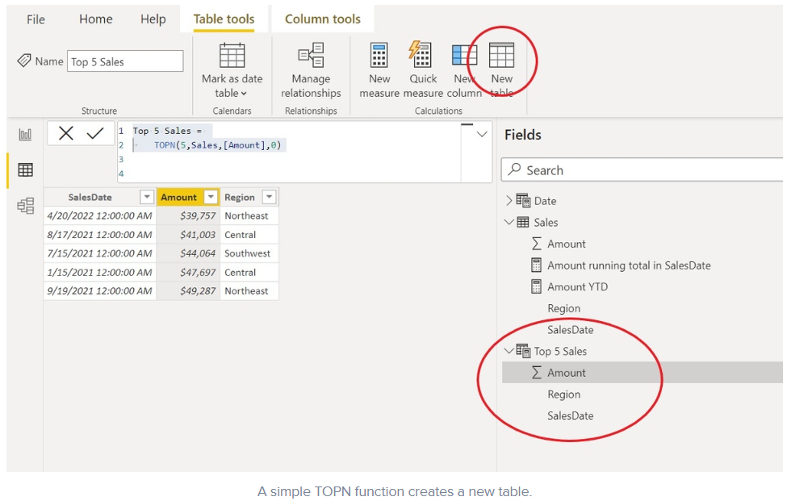
Calculated Table vs Column vs Measure
Calculated Column
Calculated Measure
Calculated Table
Notes:
https://www.analyticsvidhya.com/blog/2022/09/complete-introduction-to-dax-in-power-bi/
https://www.techrepublic.com/article/created-calculated-table-top-values-power-bi/

Slide 6
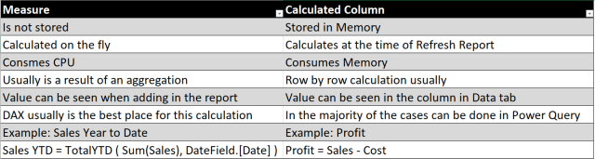
Calculated column vs Measure

Slide 7
Fundamental concepts of DAX
Syntax: Syntax is the formula which includes the functions. If a Syntax is incorrect, it will result in an error.
Functions: Functions are arguments with specific orders to perform. It helps to calculate Particular any order as required.
Context: Context are of two types: Row Context and Filter Context. Row Context is used when a formula has a Function that applies a filter to identify a row in a table. Filter Context is used when one or more filters are used to get a value.

Slide 8
DAX Data Types
Whole Number - Positive or negative integers with no decimal places.
Decimal Number - Real numbers are numbers that can have decimal places up to 17 decimal digits.
Boolean - Either a True or False value.
Text - A Unicode character data string. Can be strings, numbers or dates represented in a text format.
Date - Dates and times in an accepted date-time representation. Valid dates are all dates after March 1, 1900.
Currency - Currency data type allows values with four decimal digits of fixed precision.
Blank - A blank is a data type in DAX that represents nulls.

Slide 9
Operators in DAX
Comparison operators (=, <>, <, <=, >, >=) - To compare values and return a logical TRUE/FALSE value.
Arithmetic operators (+, -, *, /) - To perform arithmetic calculations that return numeric values.
Text concatenation operators ( & ) - To join two or more text strings.
Logical operators (&&, ||) - To combine two or more expressions to return a single result.

Slide 10
DAX Context
Two Types of Context
Row context: Row context means taking into account a specific row that has been filtered in a DAX expression. The row context focuses on the operation of the formula on the current row. This type of context is most often applied to the measure rows.
Filter context: The filter context takes focusing on values one step ahead. In row context, we were filtering out and applying operations on specific rows. But in filter context, the expression applies a filter to focus on specific values within a row. Thus, the filter context is applied in addition to the row context to narrow down the scope of calculation to specific values. Filter context is applied when we use functions like CALCULATE, FILTER, RELATED, ALL, etc.

Slide 11
DAX functions

Slide 12
Outlines
Date and Time Functions
Text Functions
Logical Functions
Math & Statistical Functions
Filter Functions
Time Intelligence functions
Table Manipulation functions
Information functions
Aggregation functions (A)/ Iterator functions (X)

Slide 13
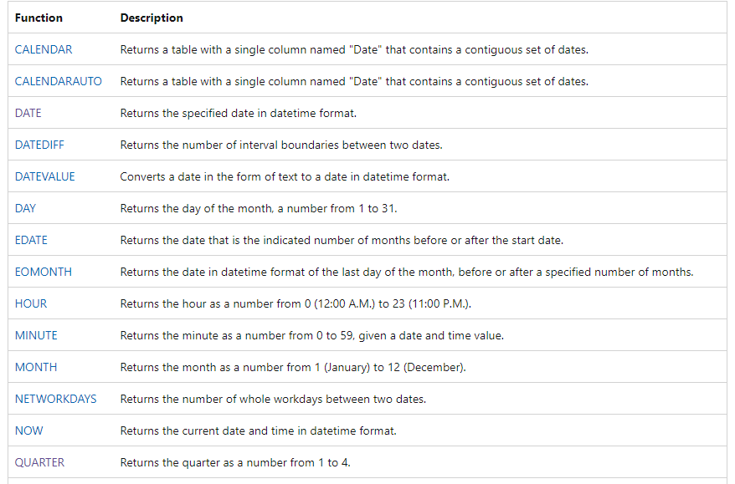
Date and Time Functions

Slide 14
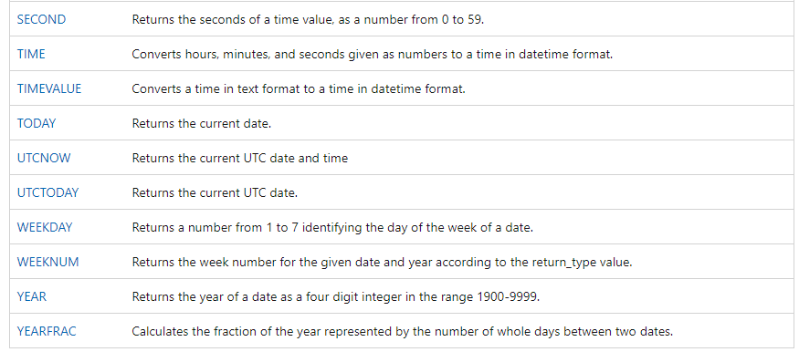
Contd..
Reference : https://learn.microsoft.com/en-us/dax/date-and-time-functions-dax

Slide 15
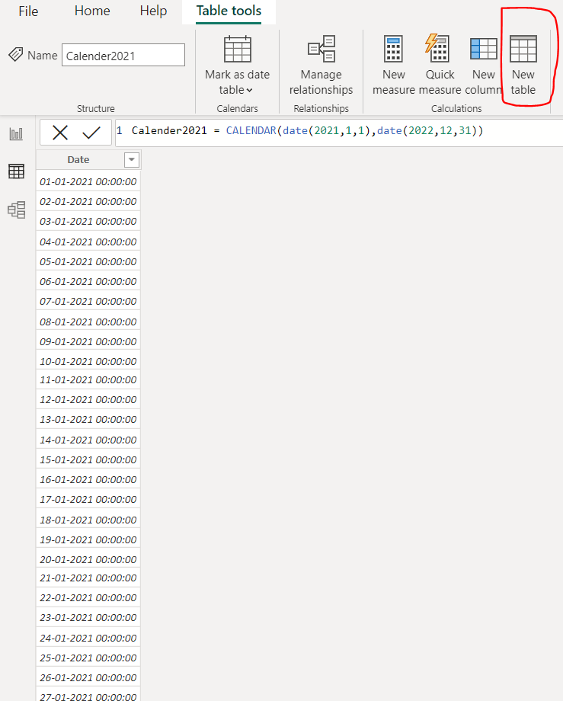
CALENDAR()
Syntax: CALENDAR(<start_date>,<end_date>)
Returns a table with single column named "Date" that contains a contiguous set of the dates
An error is returned if start_date is greator than end_date
Example : CALENDAR(Date(2020,1,1),Date(2021,12,31)
Format : YYYY,MM,DD

Slide 16
YEARFRAC():
This function returns the fractional differences b/n the start date and end date in numbers(years)
Syntax: YEARFRAC(Start_date,end_date)
Example : Age =YEARFRAC('Employees_dets'[Doj],Now())
Edate():
Returns previous dates or future dates.Adding or subtracting months
Syntax: EDATE(start_date,Months(+/-)
Example: Edate_val = EDATE('order summary'[Order_date],2)
EOMONTH():
Display the last day in a month.
Syntax: EOMONTH(start_date,Months (+,-))
Example : EMONTH_val = EOMONTH(Employee'[Doj],2)

Slide 17
DATEDIFF():
Returns the date difference b/n the start date and end date.
Third argument to select the difference values in Year, Quarter, Month, week, Day, Hour, Minute, Second.
Syntax: DATEDIFF(start_date, end_date, difference value)
Example: Datediff_val = DATEDIFF('sales'[sales.order], 'sales'[sales.shipping],Month)
CALENDARAUTO():
Returns a table with a single column named "Date" that contains a contiguous set of dates.
The range of dates is calculated automatically based on data in the model
Syntax: CALENDARAUTO([fiscal_year_end_month])
Example : CALENDARAUTO()
Note: Date column should be exist in your data model, otherwise it will give error
Date Range logic : Get min & Max date from the data model

Slide 18
Now() : Returns the current date and time in datetime format
Syntax : Now()
Today(): Returns the current date and default time 12:00:00 AM
Syntax : Today()
Date() : Returns the specified date in datetime format
Syntax : DATE (<year>, <month>, <day>)
Example : DATE(2021,2,22)
Date value() : Converts a date in the form of text to a date in datetime format
Syntax: DATEVALUE (<date_text>)
Example : DATEVALUE ("1/8/2016") returns 1/8/2016 12:00:00 AM.

Slide 19
Day() : Returns the day of the month, a number from 1 to 31.
Syntax: DAY (<date>)
Example: DAY ("3/5/2016") returns 5.
Month(): Returns the month as a number from 1 (January) to 12 (December).
Syntax: MONTH (<datetime>)
Example: MONTH ("April 5, 2016") returns 4.
Year(): Returns the year of a date as a four-digit integer in the range 1900-9999.
Syntax: YEAR (<date>)
Example : YEAR (DATE (2016,9,15)) returns 2016.
Weekday() : Returns a number identifying the day of the week of a date.
Syntax: WEEKDAY (<date>, [<return_type>])

Slide 20
Weeknum() : Returns the week number based on date value
Syntax: WEEKNUM (<date>, [<return_type>])
Note: return type 1 or 2 Default is 1
Hour() : Returns the hour as an integer from 0 (12:00 A.M.) to 23 (11:00 P.M.).
Syntax: HOUR (<datetime>)
Example: HOUR ("18:15:15") returns 18.
Minute() :Returns the minute as an integer from 0 to 59.
Syntax: MINUTE (<datetime>)
Example: MINUTE ("18:15:15") returns 15.
Second(): Returns the seconds of a time value, as a number from 0 to 59.
Syntax: SECOND (<datetime>)
Example: SECOND ("18:15:45") returns 45.

Slide 21
Demo

Slide 22
Time Intelligence Functions
CLOSINGBALANCEMONTH
CLOSINGBALANCEQUARTER
CLOSINGBALANCEYEAR
DATEADD
DATESBETWEEN
DATESINPERIOD
DATESMTD
DATESQTD
DATESYTD
ENDOFMONTH
ENDOFQUARTER
DATEDIFF
ENDOFYEAR
FIRSTDATE
FIRSTNONBLANK
LASTDATE
NEXTQUARTER
LASTNONBLANK
NEXTDAY
NEXTMONTH
TOTALMTD
TOTALQTD
TOTALYTD
SAMEPERIODLASTYEAR
PARALLELPERIOD
PREVIOUSYEAR
PREVIOUSWEEK
Notes:
https://learn.microsoft.com/en-us/dax/dax-overview

Slide 23
Time Intelligence Functions
Doing calculations over time or date periods
It needs date column to perform operations
This date column must contain
Continuous Values
No Nulls
Unique Values
To make Intelligence Functions work properly, make them Date Table

Slide 24
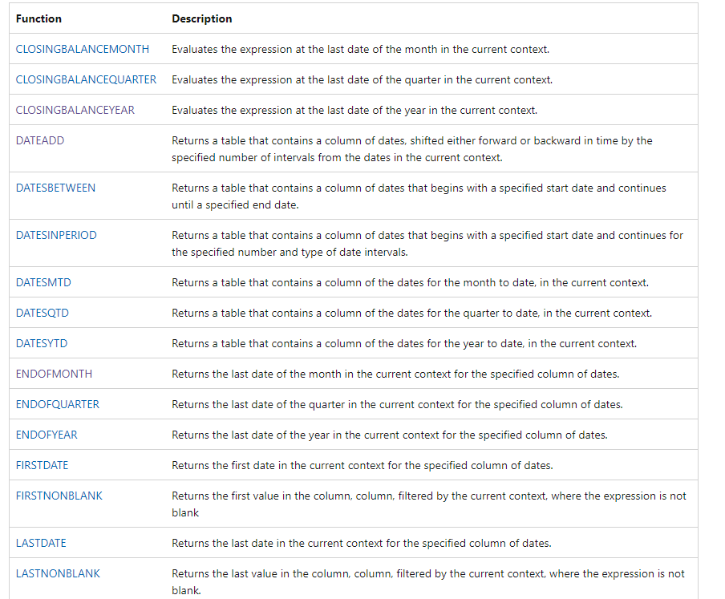
Time Intelligence Functions

Slide 25
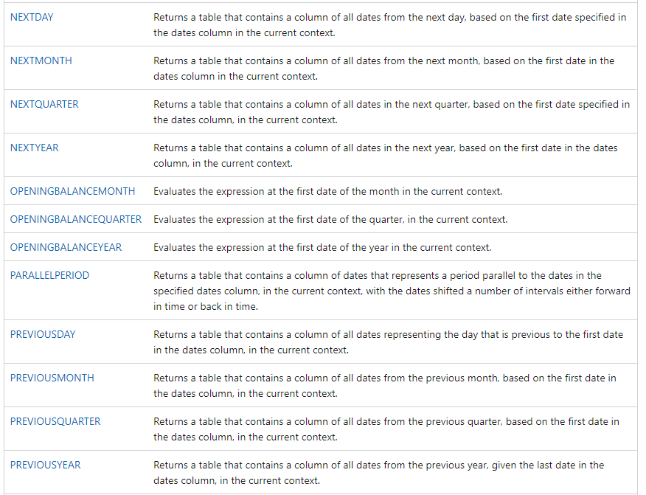
Contd..

Slide 26
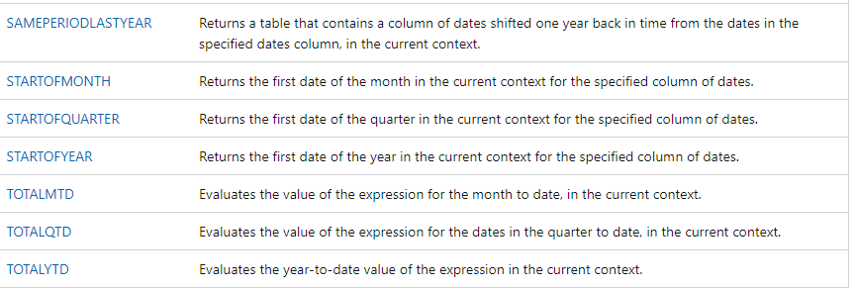
Contd..
Reference : https://learn.microsoft.com/en-us/dax/time-intelligence-functions-dax

Slide 27
Demo

Slide 28
Logical Functions
Function | Description
AND | Checks whether both arguments are TRUE, returns TRUE if both arguments are TRUE.
FLASE | Returns the logical value FALSE.
IF | Checks a condition, and returns one value when TRUE, otherwise it returns a second value.
IFERROR | Evaluates an expression and returns a specified value if the expression returns an error
IN | Restrict the calculation to specified columns
NOT | Changes FALSE to TRUE, or TRUE to FALSE.
OR | Checks whether one of the arguments is TRUE to return TRUE.
SWITCH | Evaluates an expression against a list of values and returns one of multiple possible result expressions.
TRUE | Returns the logical value TRUE.
COALESCE | Returns the first expression that does not evaluate to blank
Reference : https://learn.microsoft.com/en-us/dax/true-function-dax
Notes:
https://www.enjoysharepoint.com/power-bi-dax-logical-functions/

Slide 29
Demo

Slide 30
Text Functions
Functions:
BLANK
CODE
COMBINEVALUES
CONCATENATE
CONCATENATEX
EXACT
FIND
FIXED
FORMAT
LEFT
LEN
LOWER
MID
REPLACE
REPT
RIGHT
SEARCH
SUBSTITUTE
TRIM
UNICHAR
UPPER
VALUE

Slide 31
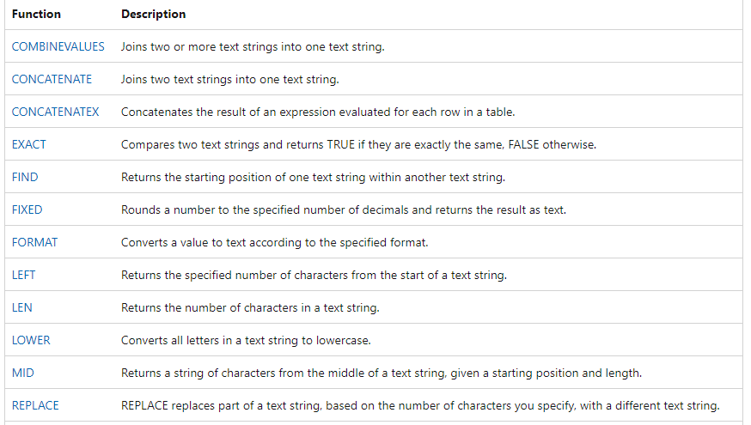
Text Functions

Slide 32
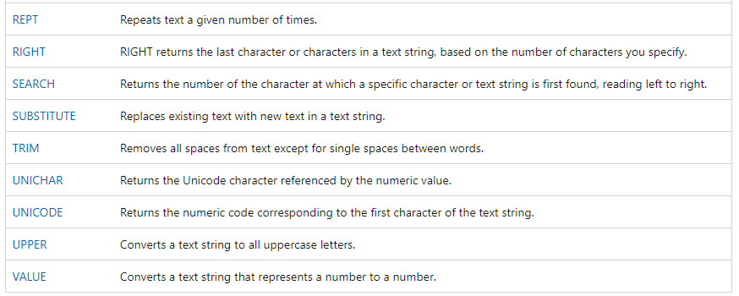
Contd..
Reference : https://learn.microsoft.com/en-us/dax/text-functions-dax

Slide 33
Demo

Slide 34
Statistical Functions / Aggregate Functions
Functions:
AVERAGE
AVERAGEA
AVERAGEX
COUNT
COUNTA
COUNTAX
RANKX
COUNTBLANK
COUNTROWS
COUNTX
DISTINCTCOUNT
GENERATE
MAX
MAXA
MAXX
MEDIAN
MEDIANX
MIN
MINA
MINX

Slide 35
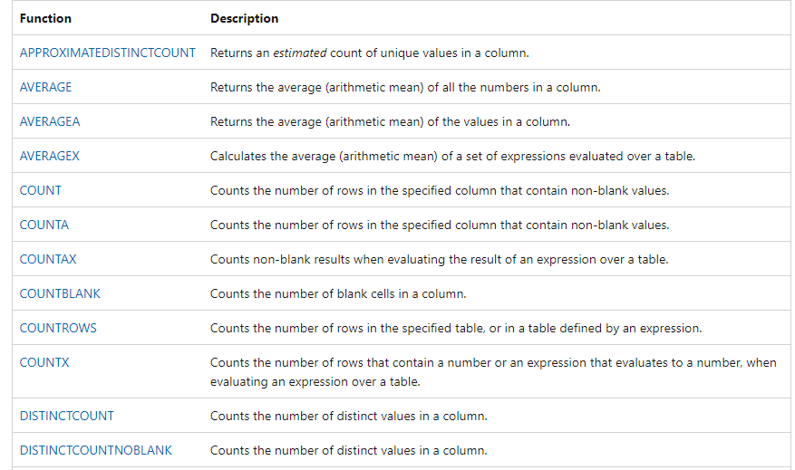
Aggregations functions

Slide 36
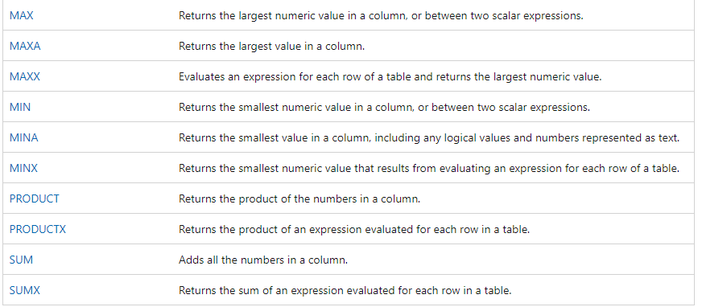
Contd..
Reference : https://learn.microsoft.com/en-us/dax/aggregation-functions-dax

Slide 37
Demo

Slide 38
Mathematical and Trigonometric Functions
Functions:
ABS
ACOS
ACOSH
ASIN
ASINH
ATAN
ATANH
CEILING
COMBIN
COMBINA
COS
COSH
CURRENCY
DEGREES
DIVIDE
EVEN
EXP
FACT
FLOOR
Reference : https://learn.microsoft.com/en-us/dax/math-and-trig-functions-dax

Slide 39
Demo

Slide 40
Table Manipulation Functions
Addcolumns
Crossjoin
Summarize
Summarizecolumns
TopN
Union
Groupby
selectcolumns
Except
Distinct
Reference: https://learn.microsoft.com/en-us/dax/table-manipulation-functions-dax

Slide 41
Demo

Slide 42
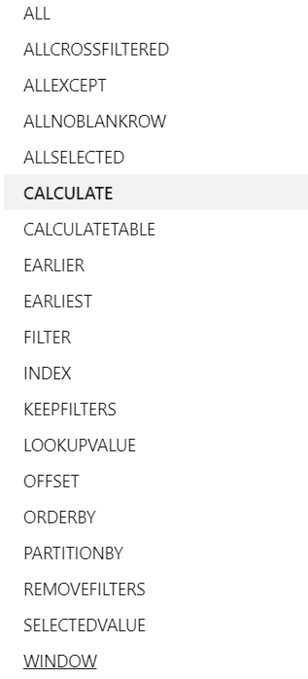
Filter Functions
ALLEXCEPT
ALLSELECTED
CALCULATE
CALCULATETABLE
FILTERS
KEEPFILTERS
ALL
LOOKUPVALUE

Slide 43
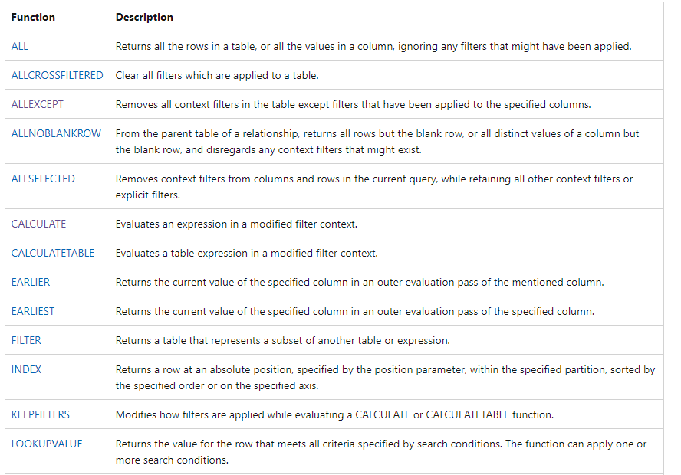
Filter Functions

Slide 44
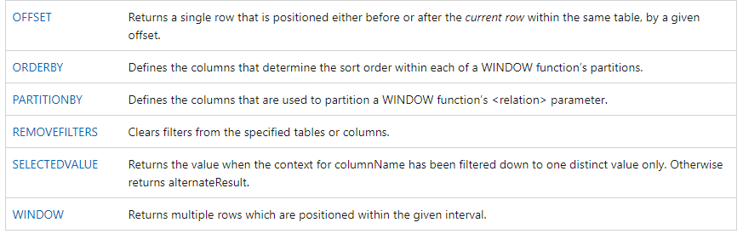
Contd..
Reference: https://learn.microsoft.com/en-us/dax/filter-functions-dax

Slide 45
Demo

Slide 46
Informational Functions
ISBLANK :
ISINSCOPE :
ISNUMBER
ISFILTERED
USERNAME
USERPRINCIPALNAME
ISTEXT
Reference : https://learn.microsoft.com/en-us/dax/information-functions-dax

Slide 47
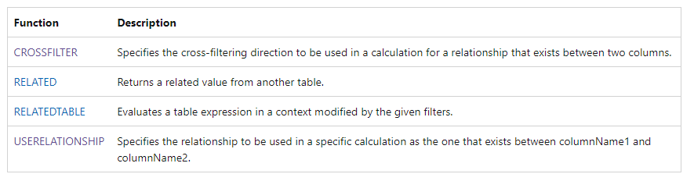
Relationship functions
Reference: https://learn.microsoft.com/en-us/dax/relationship-functions-dax

Slide 48
Demo

Slide 49
Variables in DAX
Stores the result of an expression
Which can be passed as an argument to other measure expressions
Once resultant values have been calculated for a variable expression,
those values don not change, even if the variable is referenced in another expression.
Var<name>=<expression>
[Var<name2> =<expression2>[...]]
Return <result_expression>
Syntax
Note : The result expression has access to all the variables(name,name2...) defined in the VAR

Slide 50
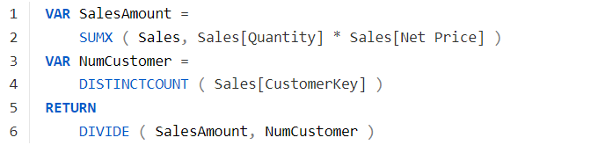
What is the use of Variables in DAX
Variables are a major feature that makes writing DAX code easier.
Moreover, It greatly increases the readability and reusability of your code.
Where can we use Variables
Variables can be used in Measures, Columns and Tables
Examples:
AddDigit =
VAR dig1 =12
VAR dig2=30
RETURN
dig1+dig2
Reference : https://learn.microsoft.com/en-us/dax/best-practices/dax-variables

Slide 51
Demo

Slide 52
DAX References
https://learn.microsoft.com/en-us/dax/dax-overview

